Slide 1

Building Interactive Apps with Android
Design & Plan

Slide 2

Check This Source
Read this blog: 9 Principles of Mobile App Design
When you finish reading, discuss some of the good tips with your group
Use Uber app as an example to discuss good and bad design (you can use any app you often interact with)

Slide 3

Build an Interactive Android App
Before you start coding, do your homework to design and plan a great app
What we will cover:
get your app to do something in response to the user,
get your activity and layout talking to each other like best buddies.
Show messages to the user using Toast
Show different ways of creating events in Android
We’ll take you a bit deeper into how Android works by introducing you to R, the hidden gem that glues everything together

Slide 4
What is R?
Android R.java is an auto-generated file by AAPT (Android Asset Packaging Tool) that contains resource IDs for all the resources of res directory
If you create any component in the activity_main.xml file, id for the corresponding component is automatically created in this file
This id can be used in the activity source file to perform any action on the component. Do you still remember the first session?

Slide 5
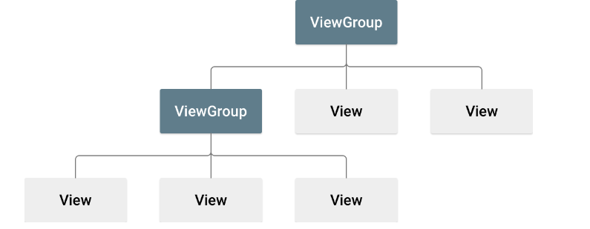
Layout
ViewGroup is the base class for Layouts in android
A layout defines the structure for a user interface in your app, such as in an activity
All elements in the layout are built using a hierarchy of View and ViewGroup objects
A View usually draws something the user can see and interact with
A ViewGroup is an invisible container that defines the layout structure for View and other ViewGroup objects and ViewGroup objects are usually called “layout”
The View objects are usually called "widgets" and can be one of many subclasses, such as Button or TextView

Slide 6
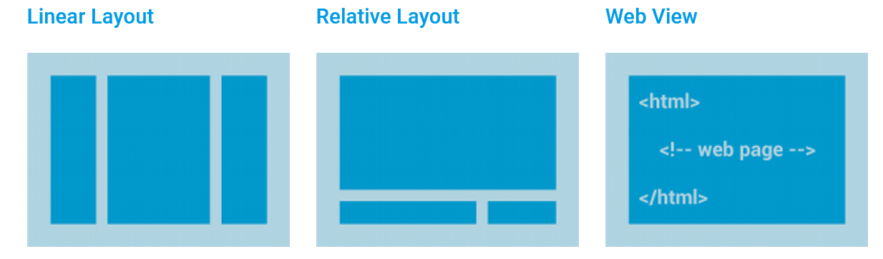
Types of Layouts
For more information about the types of Android Layouts click here
LinearLayout
RelativeLayout
ConstraintLayout
FrameLayout
CoordinatorLayout
WebView

Slide 7
How to Declare a Layout
Declare UI elements in XML. Android provides a straightforward XML vocabulary that corresponds to the View classes and subclasses, such as those for widgets and layouts. You can also use Android Studio's Layout Editor to build your XML layout using a drag-and-drop interface.
Instantiate layout elements at runtime. Your app can create View and ViewGroup objects (and manipulate their properties) programmatically. You can use RecyclerView or a subclass of AdapterView for a dynamic layout.

Slide 8
Write the XML
<?xml version="1.0" encoding="utf-8"?> <LinearLayout xmlns:android="http://schemas.android.com/apk/res/android" android:layout_width="match_parent" android:layout_height="match_parent" android:orientation="vertical" > <TextView android:id="@+id/text" android:layout_width="wrap_content" android:layout_height="wrap_content" android:text="Hello, I am a TextView" /> <Button android:id="@+id/button" android:layout_width="wrap_content" android:layout_height="wrap_content" android:text="Hello, I am a Button" /> </LinearLayout>

Slide 9
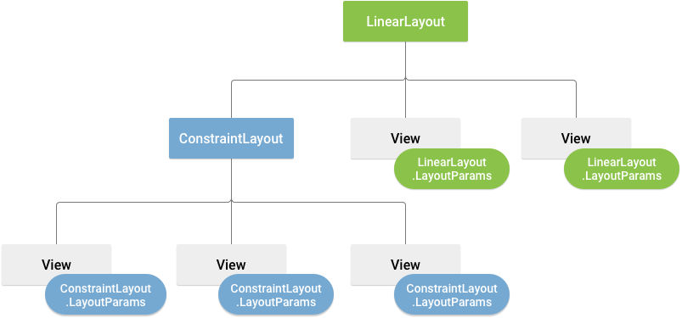
Layout Parameters
XML layout attributes named layout_something define layout parameters for the View that are appropriate for the ViewGroup in which it resides
Every ViewGroup class implements a nested class that extends ViewGroup.LayoutParams
This subclass contains property types that define the size and position for each child view, as appropriate for the view group

Slide 10

Layout Parameters
All viewgroups include a width and height (layout_width and layout_height), and each view is required to define them
Many LayoutParams also include optional margins and borders
You can specify width and height with exact measurements, though you probably won't want to do this often
More often, you will use one of these constants to set the width or height:
wrap_content tells your view to size itself to the dimensions required by its content
match_parent tells your view to become as big as its parent viewgroup will allow
It is recommended to use relative measurements such as density-independent pixel units (dp), wrap_content, or match_parent to ensure that your app will display properly across a variety of device screen sizes

Slide 11

Layout Position
getLeft() returns the left, or X, coordinate of the rectangle representing the view
getTop() returns the top, or Y, coordinate of the rectangle representing the view
getRight() and getBottom() return the coordinates of the right and bottom edges of the rectangle representing the view
These methods both return the location of the view relative to its parent.

Slide 12
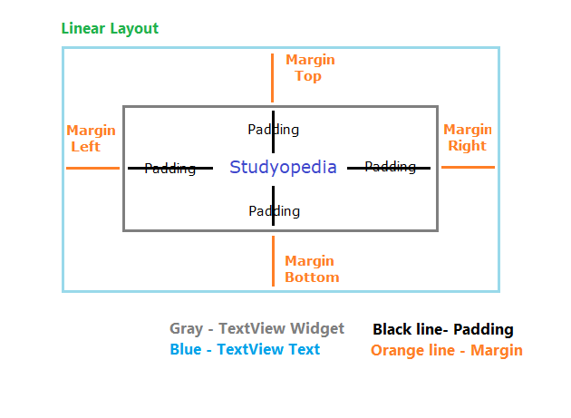
Size, Padding and Margins
getWidth() and getHeight() methods returns the width and height of the view
Padding can be set using the setPadding(int, int, int, int) method and queried by calling getPaddingLeft(), getPaddingTop(), getPaddingRight() and getPaddingBottom()
Even though a view can define a padding, it does not provide any support for margins

Slide 13
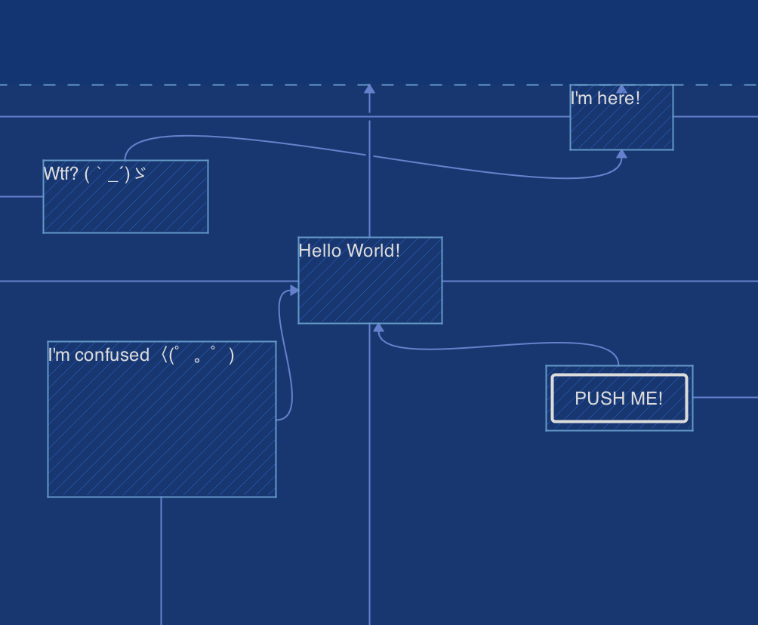
ConstraintLayout
ConstraintLayout is mainly designed for the new programmers so that they can easily design the layout using the Visual Editor instead of building the layout with hand via XML
Click this Link and watch the video and see an example

Slide 14
Exercise
Go to Android Studio's Layout Editor and read through the instructions of how to use this editor in detail. After finishing reading make sure you are able to do the following:
Create a new project called “MyFirstInteractiveApp” with a button and textview
Run your app
Change the UI elements attributes in the design editor
Change the orientation of the app and rerun
Design using different types of devices (use appropriate buttons from the Layout Editor)
Change the layout to Linearlayout and check the xml code, make sure that you return it to ConstraintLayout and check the difference
Add a new layout file to your project and check the project explorer to check the structure of your project

Slide 15
Extra Reading Resource
More of the up-to-date material about Android Design is here: UI Design | Android Developers

